Slide 1
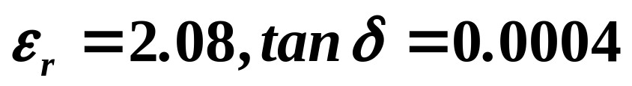
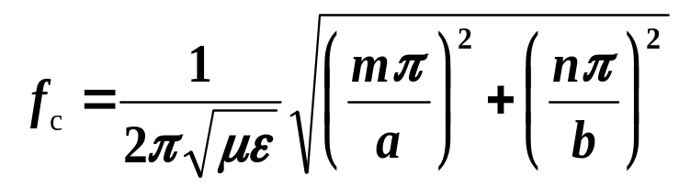
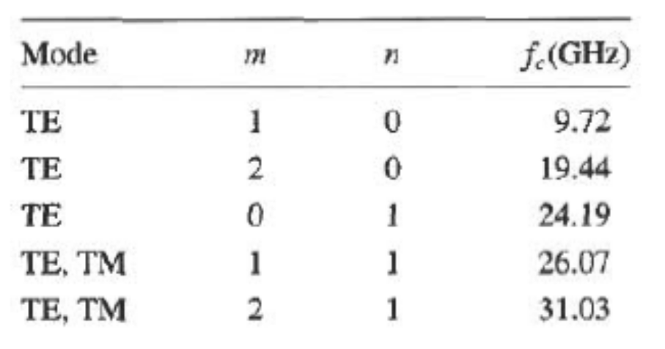
§4.2 rectangular waveguide
4. Example: Characteristics of a rectangular waveguide
Consider a length of Teflon-filled copper K-band rectangular waveguide, a*b=1.07cm *0.43cm. Finding the cutoff frequencies of the first five propagating modes. If the operating frequency is 15GHz, find the attenuation due to dielectric and conductor losses
Solution： for Teflon
TE₁₀、TE₂₀、TE₀₁、TE_{11、}TM₁₁ mode will be the first five modes to propagate

Slide 2
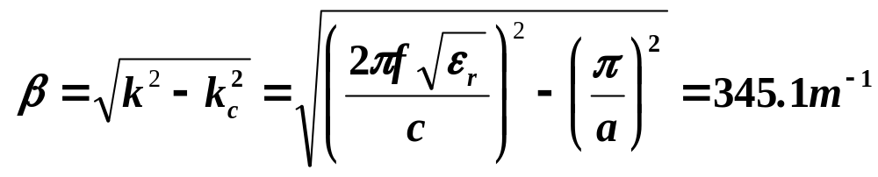
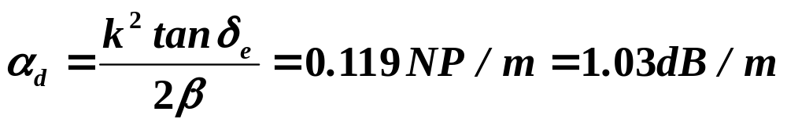
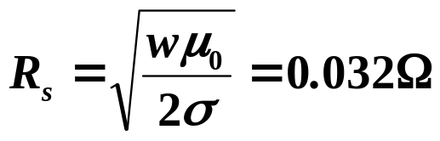
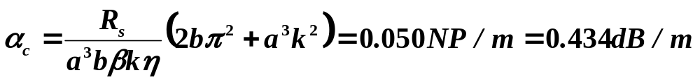
§4.2 Rectangular waveguide
Attenuation due to dielectric loss:
Surface resistivity of the copper wall is (σ=5.8*10⁷S/m)
Attenuation due to conductor loss:

Slide 3
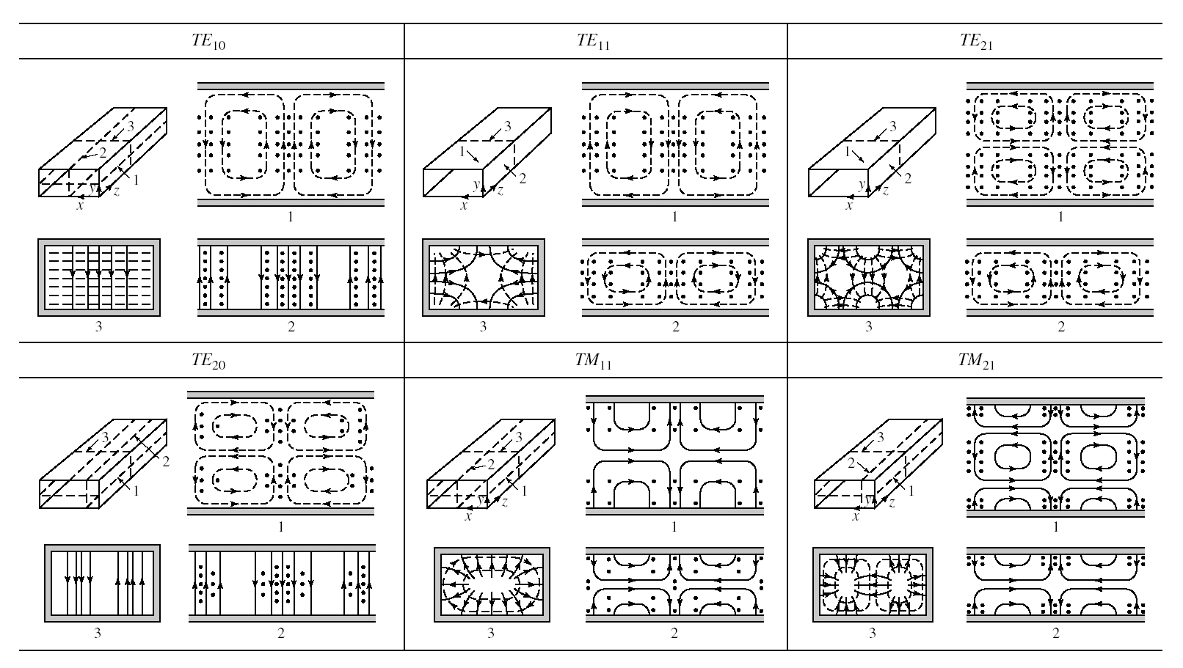
Field lines for some of the lower order modes of a rectangular waveguide.
§4.2 Rectangular waveguide
5. Field Structures

Slide 4
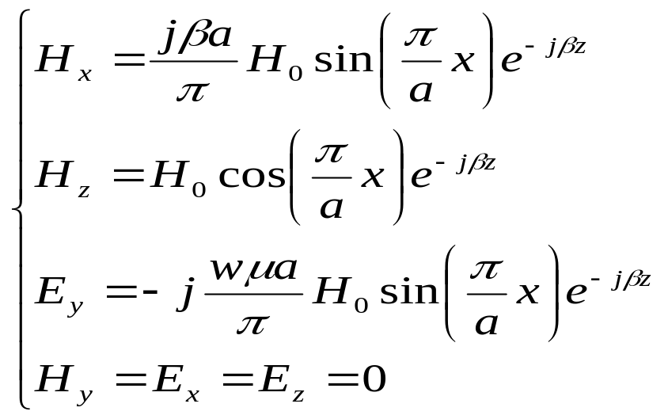

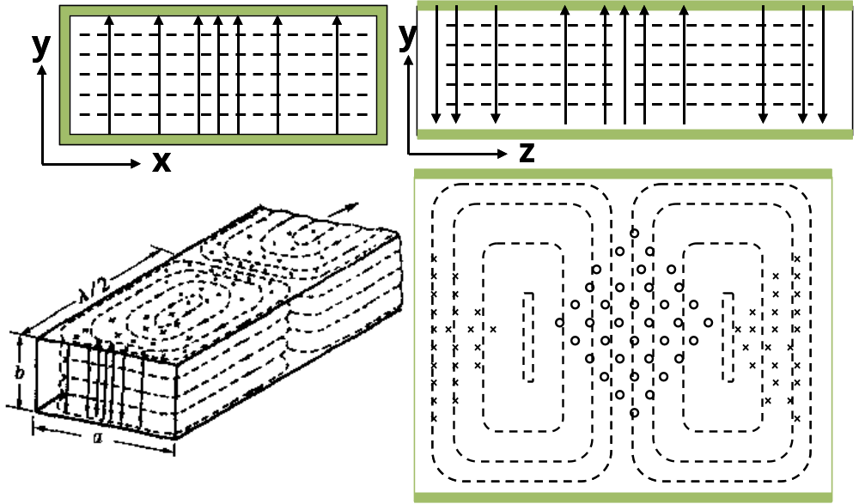
§4.2 Rectangular waveguide
m=1, n=0
x
z

Slide 5
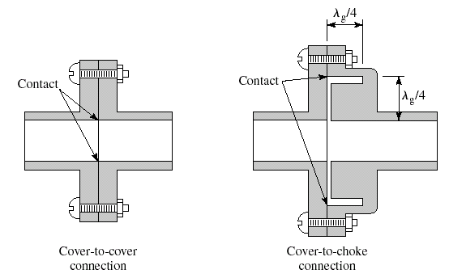
§4.2 Rectangular waveguide
6 Waveguide Flanges

Slide 6
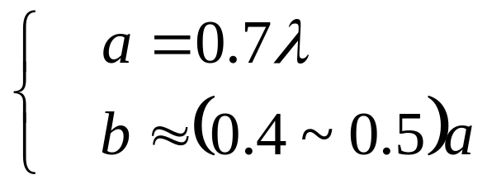
§4.2 Rectangular waveguide
7 Waveguide Size

Slide 7
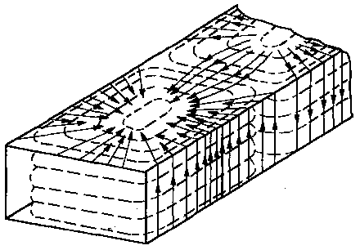
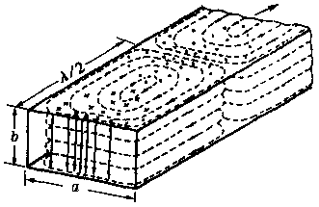
§4.2 Rectangular waveguide
8. Wall current/ surface current for TE₁₀ mode

Slide 8
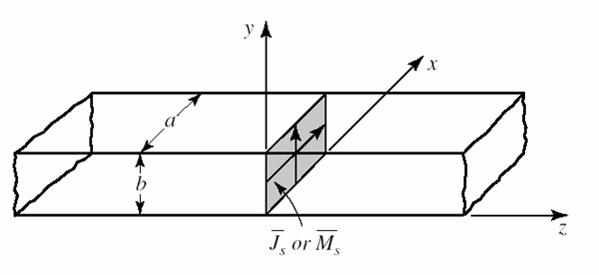
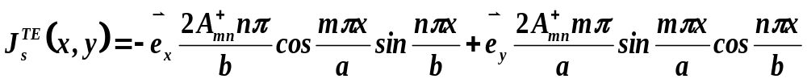
§4.2 Rectangular waveguide
9. Excitation of waveguides
Assume that this current has x and y components given as:
Such a current excites a single TEmn waveguide mode traveling away from the current source in both the +z and –z directions
But such currents are very difficult to generate, and are usually only approximated with one or two probes or loops. In this case many modes may be excited, but usually most of these modes are evanescent.

Slide 9
§4.2 Rectangular waveguide——_9. Excitation of waveguides
（1）Probe-Fed rectangular waveguide
（2）loop-Fed rectangular waveguide
（3）aperture coupling

Slide 10
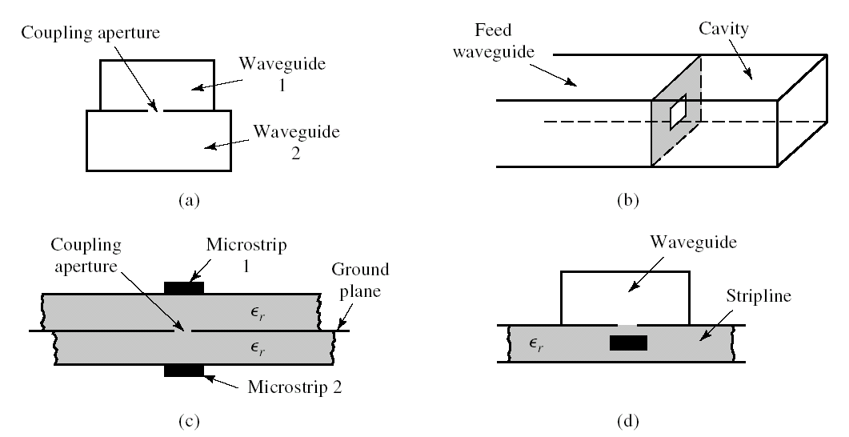
§4.2 Rectangular waveguide——_9. Excitation of waveguides
Various waveguide and other transmission line configurations using aperture coupling. (a) Coupling between two waveguides with an aperture in the common broad wall. (b) Coupling to a waveguide cavity via an aperture in a transverse wall. (c) Coupling between two microstrip lines via an aperture in the common ground plane. (d) Coupling from a waveguide to a stripline via an aperture.

Slide 11
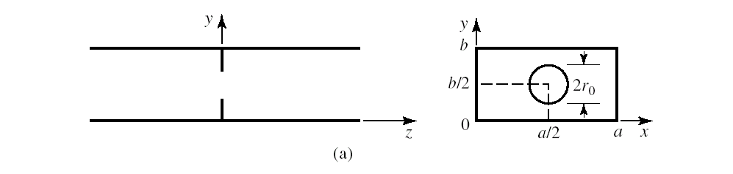
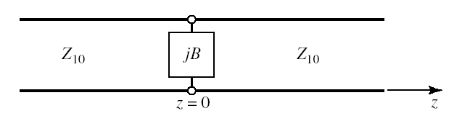
§4.2 Rectangular waveguide——_9. Excitation of waveguides
Equivalent circuit of the aperture in a transverse waveguide wall

